Slide 1

POWER BI FOR DATA ANALYTICS
Empower Your Data Analysis and Visualization

Slide 2

Meet the facilitator
Working as a Data Analyst/Scientist at Codar Institute of Technology.
With Valuable years of experience in Data Cleaning, Data Exploration, Data Visualization, Data Modeling etc.
I am comfortable working with Excel, Power BI, SQL, Tableau and Python Programming Language for Analyzing and Visualizing Data.
Hobbies: Watching Movies and Playing Football

Slide 3
Course content:
Installation of Power BI Software
Introduction to Power BI and its Interface
Getting Data from different Data Sources
Data Transformation using Power Query Editor
Data Analysis and Visualization
Data Modelling

Slide 4
MODULE 1: Basics of PowerBI
Empower Your Data Analysis and Visualization

Slide 5
Outline:
What is PowerBI
Components of PowerBI
Installation of PowerBI
Understanding the Interface of PowerBI
Getting Data from Common Sources
Who uses PowerBI
Benefits of PowerBI

Slide 6
What is Power BI?
Microsoft Power BI is an interactive data visualization software product developed by Microsoft with a primary focus on business intelligence.
Power BI is a collection of software services, apps, and connectors that work together to turn your unrelated sources of data into coherent, visually immersive, and interactive insights.
Data may be input by reading directly from a database, webpage, PDF, or structured files such as spreadsheets, CSV, XML, and JSON.

Slide 7
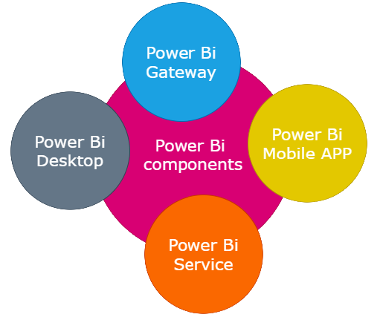
Component of Power BI
Gateway: It is used to create connection between Power BI cloud Reports Data set and the data source located on-premises.
Mobile Apps: Using Power BI mobile apps, you can stay connected to their data from anywhere. Power BI apps are available for Windows, iOS, and Android platform.
Power BI Desktop: It is free desktop application you can install this in your local computer & it is used to create reports and data visualizations on the data set.
Power BI Service: Power BI allows you to publish Power BI Desktop reports and data visualizations into Power Bi cloud.

Slide 8
Installation of Power BI
Installing Power BI Desktop (Windows):
Download: Go to the official Power BI website (https://powerbi.microsoft.com/) and navigate to the "Products" section. Click on "Power BI Desktop" and then click "Download" to get the installer.
Run Installer: Locate the downloaded installer file and run it. The installer will guide you through the installation process.
License Agreement: Read and accept the license agreement to proceed.
Installation Location: Choose the installation location for Power BI Desktop or accept the default location.
Start Menu Shortcut: Decide whether you want to create a shortcut in the Start menu.
Complete Installation: Click on "Install" to start the installation. Once completed, click "Finish" to close the installer.

Slide 9
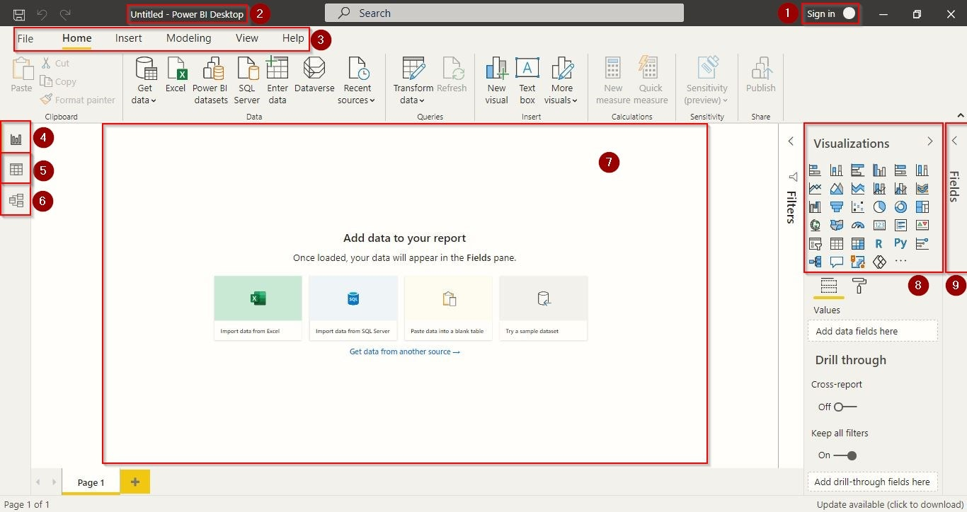
Understanding the Interface of PowerBI
Sign-Up for Power BI
Project Name
Menus
Report View
Data View
Model View
Canvas
Visuals
Queries Fields

Slide 10
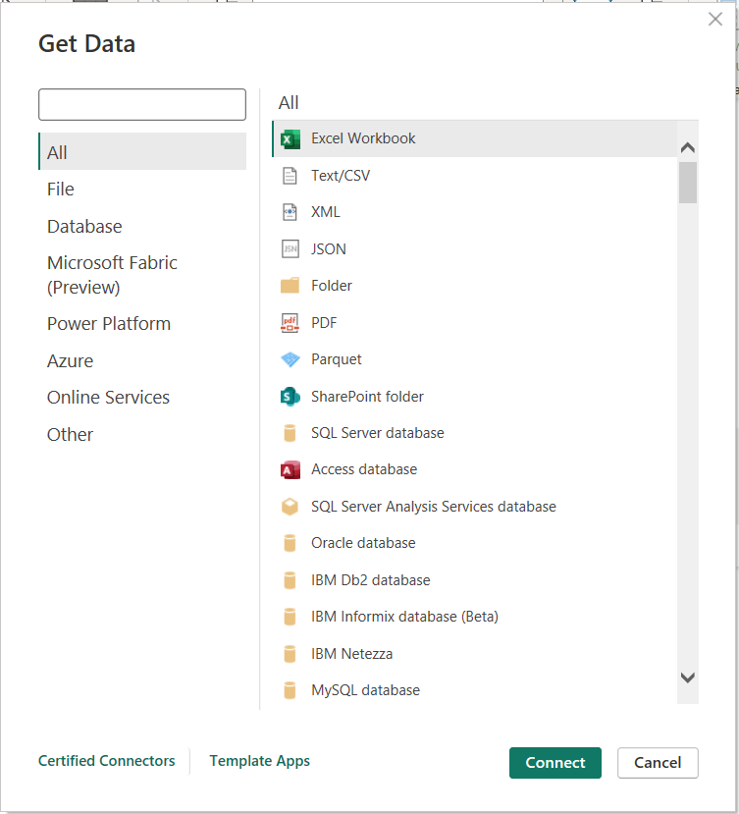
Getting Data from Common Sources
Excel Workbook
Text/CSV
Access Database
MySQL Database
Folder
Web

Slide 11
Who Uses Power BI
Mostly used by Technical or Data Analyst professionals but Non-Technical users also can use this.
It is very easy to use, within a few clicks you can create attractive visualizations for your business and no longer business users depends on IT person for gathering, transforming and analyzing data.

Slide 12
Benefits of Power BI
We can handle large amount of data easily.
More than 30+ visualization are available to using them we can create dashboard & reports.
Power BI support more then 200 DAX functions to using them we can perform complex calculations.
We can gather, transform, analyze, publish and share the data in Power BI.

Slide 13
MODULE 2: Power Query & Data Transformation
Empower Your Data Analysis and Visualization

Slide 14
Outline:
Power Query Editor
Data Transformation:
Choose Columns
Remove Columns
Keep Rows
Remove Rows
Promote Headers
Remove Errors
Extract Option
Split Columns
Merge Columns
Use first Row as Header
Replace Values
Data Types
Merge Queries
Append Queries
Add Columns
Conditional Columns
Column from Examples
Custom Columns
Pivot and Unpivot

Slide 15
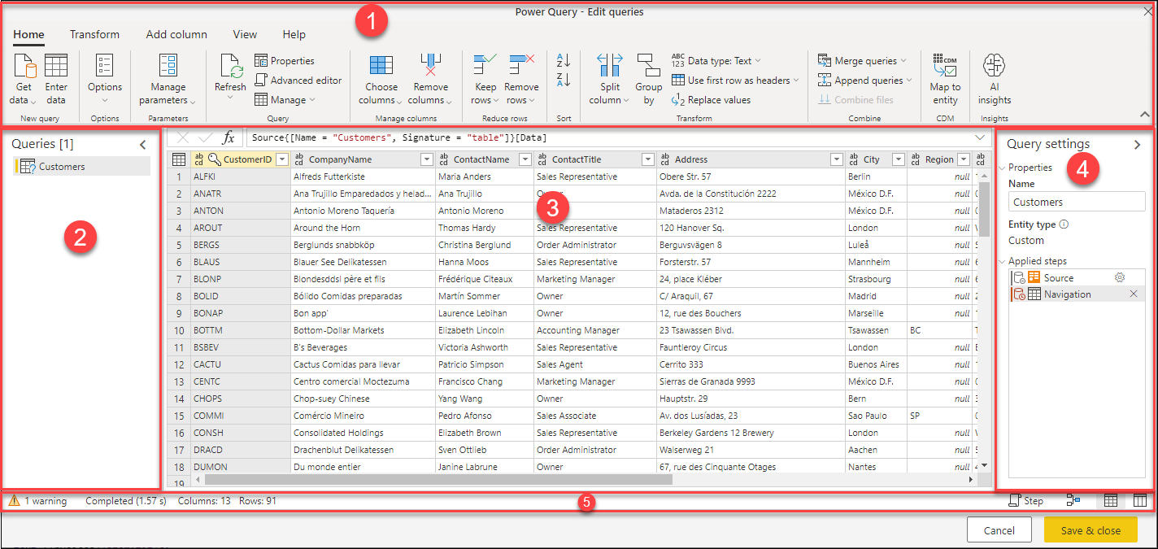
Power Query Editor
Ribbon
Queries Pane
Current View
Query Settings
Status Bar

Slide 16
MODULE 3: Data Modelling
Empower Your Data Analysis and Visualization

Slide 17
Outline:
Fact-Dimension Model
Creating Relationship in Data Model
Cardinality: One-One, Many-One, One-Many, Many-Many Relationship
Filter Direction: Single and Double

Slide 18
Denormalization and Normalization
Database normalization is the process of structuring a relational database in accordance with a series of so-called normal forms to reduce data redundancy and improve data integrity.
Normalization is a database design technique that organizes tables in a manner that reduces redundancy and dependency of data by minimizing the insertion, deletion and update anomalies through eliminating the redundant data.
Denormalization is the inverse process of normalization where the redundancy is added to the data intentionally to improve the performance of the specific application and data integrity.

Slide 19
Data Modelling
Data Modeling is the process of creating a data model. These Data Models are abstract data that defines the data structure, properties and relation.
Fact and Dimension Tables
Fact tables and dimension tables are key components of a schema in a data warehouse.

Slide 20
Cardinality
Cardinality defines the number of relation from one table to another table. There are mainly 3 types of cardinality in a table.
One to One Cardinality – In this type of cardinality, One entity attribute creates only one connection with another attribute.
One to Many Cardinality – In this cardinality, one entity attribute creates multiple connections with another attribute.
Many to Many Cardinality – In this cardinality, multiple entities from one table creates multiple relations with other tables.

Slide 21
MODULE 4: DAX
Empower Your Data Analysis and Visualization

Slide 22
Outline:
Fundamentals of DAX
What is DAX
Uses of DAX
Concept of DAX
How DAX works
Types of DAX Functions
Aggregate Functions
Date and Time Functions
Time Intelligence Functions
Filter Functions
Relationship Functions
Logical Functions
Text Functions

Slide 23
DAX: Data Analysis Expression
DAX is a library of functions and operators that can be combined to build formulas and expressions used by Microsoft BI Tools.
DAX is also known as a Function Language, where the full code is kept inside a function.
Where DAX can be used:
Power BI
Power Pivot for Excel
SSAS Tabular Model
Azure Analysis Services
DAX Studio

Slide 24
Purpose of DAX
By using Data Analysis Expressions (DAX)
You can add four types of calculations to your Data Model.
Calculated Columns
Measures
Calculated Tables
Row-Level Security

Slide 25
Calculated Column Vs Measures
Calculated Column
VS
Measure
Expands Table by Creating new column
Stores along with table.
Consume Memory
Less Analytic Capability
Summarize a data into a single value
Calculate at runtime/ stored temporarily
Rich Analytical Capabilities
Total Sales = Sum([Sales Amount])
Total Profit = Sum([Sales Amount]) - Sum([Cost Amount])
Profit =
[Sales Amount] – [Cost amount]

Slide 26
Calculated Tables
Date Tables
Role-playing Dimensions
What-if-Analysis

Slide 27
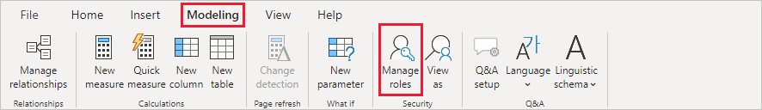
Row-Level Security (RLS)
Row-level security (RLS) with Power BI can be used to restrict data access for given users.

Slide 28
Fundamental of DAX: Syntax
DAX formulas are very similar to the Excel Formulas, but there are some key differences.
In Microsoft Excel you can reference individual cells or arrays, but in DAX you can reference only complete tables of columns of data.
DAX formulas do not support exactly the same data types as Microsoft Excel.

Slide 29
Fundamental of DAX: Syntax
Total Sales = Sum(‘Fact Sales’[Sales Amount])

Slide 30
Fundamental of DAX: Operators
Operator Type | Symbol | Uses
Parenthesis Operator | () | Precedence order and grouping of arguments
Arithmetic Operators | + - * / ^ | Addition Subtraction Multiplication Division Exponential
Comparison Operators | = > < >= <= <> | Equal to Greater than Less than Greater than or equal Less than or equal Not equal
Text Concatenation | & | Concatenation
Logic Operators | && || | And or

Slide 31
Fundamental of DAX: Data Types
Information | PowerBI Data Types
Customer Name, Address, Product Name | Text
Sales Amount, Quality, Age | Whole Number, decimal
Sales Date, Birth Date, Time | Date Time, Date, Time
Is Valid, Accepted/Rejected | True / False

Slide 32
TASKS:
Instructions
Using your knowledge of Calculated Column, Calculated Table, Measures and Row Level Security as a guide, you should create the following:
A Calculated Column to get the Net Sales. (Net Sales is the total Sales value after deducting discounts)
2. A Calculated Table, with the Orders containing only Same Day shipment.
3. A Measure to determine the Average of Net Sales. Visualize this by Products Category.
4. A Row Level Security, having roles for any two Sales Team Managers, allowing them view data for only their teams.

Slide 33
Pillars of DAX
Tables – understanding data model, table relationships, filter directions
Functions – know function classes, behavior, manipulate tables with functions
Evaluation Context – Know how to manipulate filters and rows in a formula

Slide 34
Understanding Cross Filtering Direction
Each model relationship is defined with a cross filter direction.
Single cross filter direction means "single direction", and Both means "both directions". A relationship that filters in both directions is commonly described as bi-directional.
Cardinality type | Cross filter options
One-to-many (or Many-to-one) | Single Both
One-to-one | Both
Many-to-many | Single (Table1 to Table2) Single (Table2 to Table1) Both

Slide 35
DAX Functions
DAX is mostly about using functions
Most functions have input requirements called “Arguments”. Arguments can be Column, Table, Expression, filter or optional
Functions can be classified based on their result (Scalar or Table) or by their purpose.

Slide 36
SIMPLE AGGREGATORS
LOGICAL
TIMEINTELLIGENCE
IF
SWITCH
AND
OR
COALESCE
TRUE
FALSE
FILTER
PRVIOUSMONTH
PREVIOUSYEAR
PREVIOUSQUARTER
DATESYTD
DATESMTD
DATESQTD
TOTALYTD
TOTALMTD
TOTALQTD
SAMEPERIODLASTYEAR
PARALLELPERIOD
SUM
AVERAGE
MIN
MAX
COUNT
COUNTA
COUNTROWS
FILTER
CALCULATE
CLACULATETABLE
ALL
ALLEXCEPT
ALLSELECTED
SELECTEDVALUE
REMOVEFILTERS
KEEPFILTERS
EARLIER
RELATIONSHIP
RELATED
RELATEDTABLE
CROSSFILTER
USERELATIONSHIP
TEXT
ITERATING AGGREGATORS
LEFT
RIGHT
MID
FORMAT
VALUE
SUMX
AVERAGEX
MINX
MAXX
COUNTX
RANKX
OTHER TABLE
VALUES
DISTINCT
TOPN
ADDCOLUMNS
SUMMARIZE

Slide 37
Using SWITCH Functions
Create a Calculated Column: Quantity Category
Quantity Cat = SWITCH(TRUE(),
Orders[Quantity] < 5, “Small”,
Orders[Quantity] >= 5 && Orders[quantity] <= 10, “Large”, “Bulk”
)

Slide 38
Using RELATED Functions
Create a Calculated Column: City
Use the Related Function to return the city column from Location Table
City = RELATED(Location[City])

Slide 39
Table Functions
This functions can be use to define tables to be used in our formulars.
ALL
ALLEXCEPT
ALLSELECTED
VALUES
DISTINCT
FILTER

Slide 40
MODULE 5: DAX Context
Empower Your Data Analysis and Visualization

Slide 41
Outline:
How DAX Works
Row Context
Filter Context
Concept of DAX
How DAX works
Types of DAX Functions
Aggregate Functions
Date and Time Functions
Time Intelligence Functions
Filter Functions
Relationship Functions
Logical Functions
Text Functions

Slide 42
Row Context Vs Filter Context
Row Context - does calculation row by row. In Calculated Column and Measures with the Iterators.
Filter Context - does calculations after taking a subset of the data based on all selections.

Slide 43
SIMPLE AGGREGATORS
ITERATING AGGREGATORS
SUM
AVERAGE
MIN
MAX
COUNT
COUNTA
COUNTROWS
SUMX
AVERAGEX
MINX
MAXX
COUNTX
RANKX

Slide 44
Aggregating
Find the Total Sales
Find the Total Costs
Revenue = Sum(Orders[Sales]
RevenueX = Sumx(Orders, Orders[Sales]

Slide 45
Aggregating on a Filter Table
Find the Revenue for Furniture Products
Furniture Revenue = SumX( Filter(Orders, Related(Products[Category]) = “Furniture”),
Orders[Sales])

Slide 46
TASKS:
Write a new Measure for "Same Day Sales". Visualize this using a Card Visualization type
2. Write a new Measure for "Consumer Sales". Visualize this using a Card Visualization Type

Slide 47
Filter Context
Filter Context
Filter Context is, set of filters that applied before that table arrives for us.
Total Sales = Sum(Sales[Sales Amount])
Applying filters from Filter pane / Visuals/ Slicers (Year = 2017, Country= USA)

